Slide 1
Optical Character Recognition
AI YEAR3
Doaa Mohamed 20218003
Omar Ahmed 20218007
Sohila Mustafa 20218019
Rana Amr 20218004

Slide 2
Optical Character Recognition (OCR):-
This project is based on Tesseract. What is tesseract?
Tesseract is an open-source Optical Character Recognition (OCR) engine developed by Google. OCR technology is used to convert different types of documents, such as scanned paper documents, PDFs, or images captured by a digital camera, into editable and searchable data.
Key features of Tesseract OCR include:
Open Source: Tesseract is an open-source project, which means that its source code is freely available to the public. This allows developers to study, modify, and contribute to the development of the OCR engine.
Multilingual Support: Tesseract supports a wide range of languages, making it suitable for applications in various regions around the world.
Accuracy: Tesseract is known for its accuracy in recognizing text, especially in diverse and challenging scenarios. It performs well on different types of fonts, sizes, and styles.
Adaptability: Tesseract can be adapted for different use cases and scenarios. It supports training on new fonts and languages, allowing developers to improve its performance on specific tasks.
Command Line Interface: Tesseract can be used from the command line, making it easy to integrate into various applications and scripts.

Slide 3
When using Tesseract with Python, the pytesseract library is commonly used to interface with the Tesseract OCR engine.
Steps of the project
Read the Image:
-Load an image from a file
Image Preprocessing:
-Normalize the image.
-Apply thresholding to create a binary image.
-Perform Gaussian blur for smoothing.
OCR (Optical Character Recognition):
-Use Tesseract OCR on a different image ('good3.png').
-Extract text from the image.
Display OCR Result:
-Print the extracted text.
Visualize Results on Original Image:
-Read another image ('good2.png') for visualization.
Define OCR Results:
-Specify OCR results (e.g., bounding box coordinates)
Annotate Original Image:
-Draw rectangles around recognized text regions.
-Display text and confidence level on the image.
Display Annotated Image:
-Visualize the original image with OCR results.

Slide 4
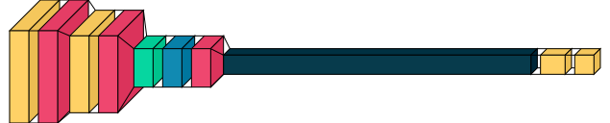
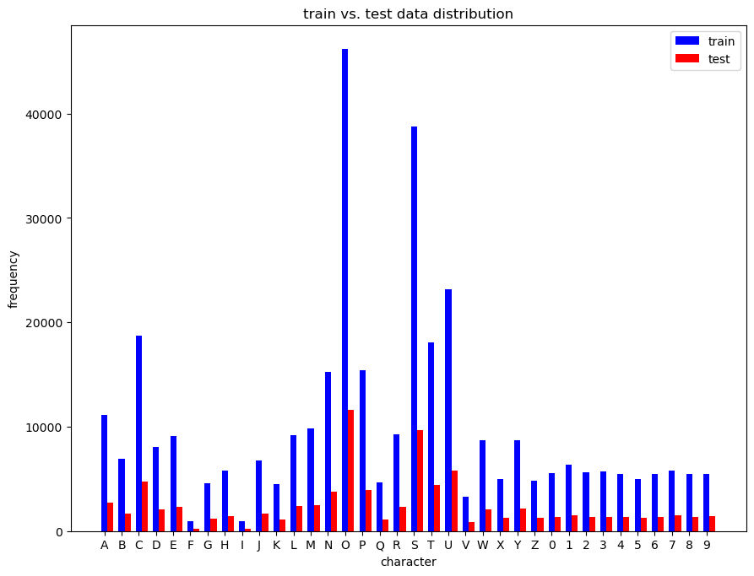
Model view:

Slide 5
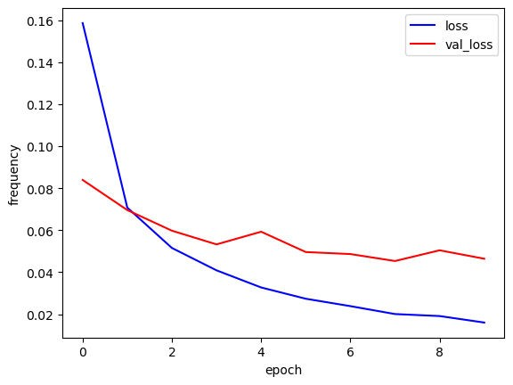

Slide 6
